Slide 1
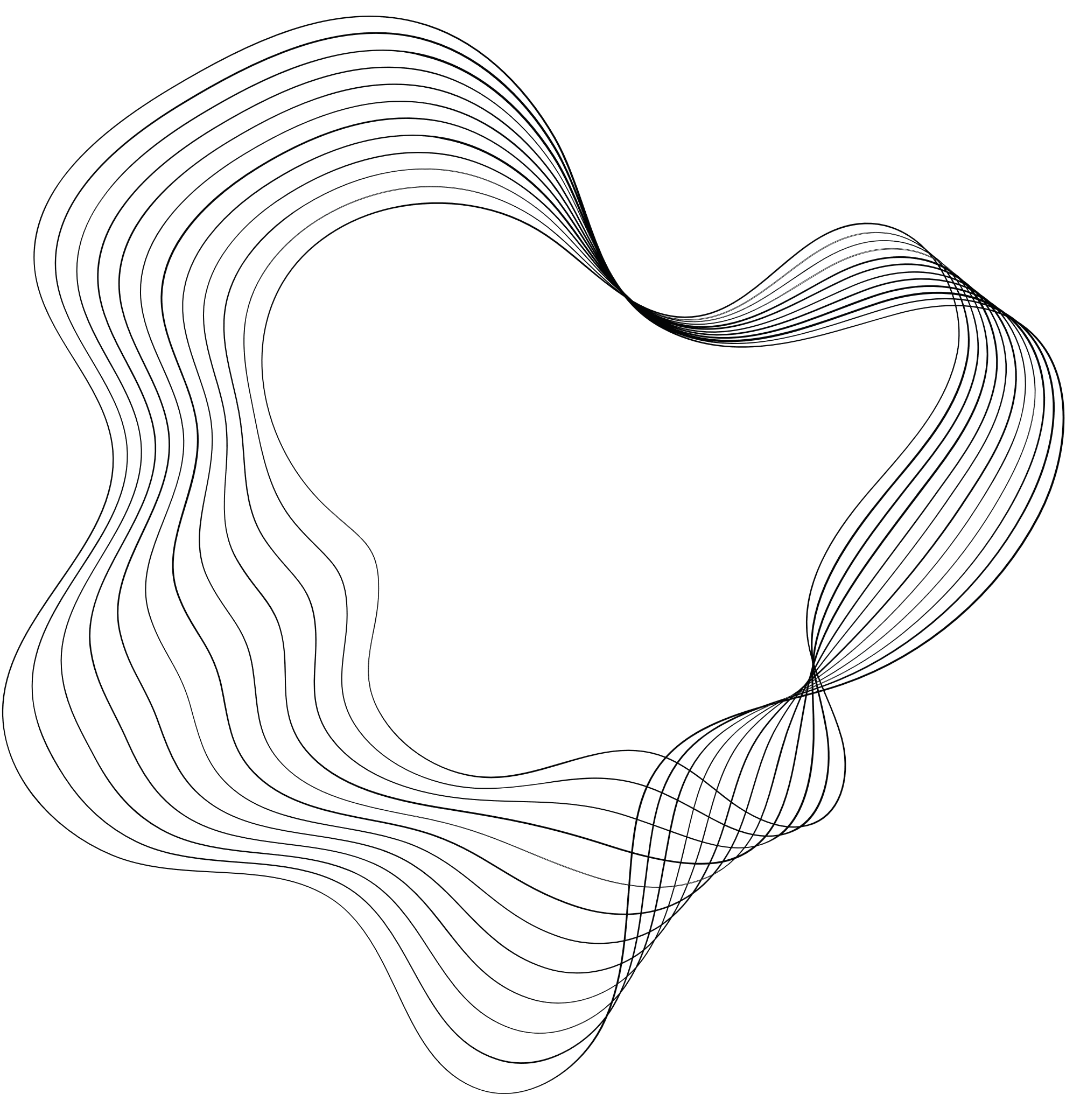

STAT3011 GROUP6
PROJECT
E-COMMERCE CUSTOMER ANALYTICS​
CHEN Qin 1155173025
XIA Zhiqiu 1155173539
GUAN Xiaoya 1155173856
HUANG Siying 1155173673
CHEN Linxiao 1155173754
ZHONG Shengyuan 1155156303

Slide 2


PROBLEM STATEMENT
Question
Can we categorize the customers in a particular segment based on their buying patterns?
Input: We will be using e-commerce data that contains the list of purchases in 1 year for 4,000 customers.
Output: The goal is that we need to categorize our consumer base into appropriate customer segments.

Slide 3

CONTENT
01
DATA PREPROCESSING
02
DEFINING PRODUCT CATEGORIES
03
CUSTOMER SEGMENTATION
04
RECOMMENDER SYSTEM(CLASSIFIER)

Slide 4



01
——DATA PREPROCESSING——

Slide 5

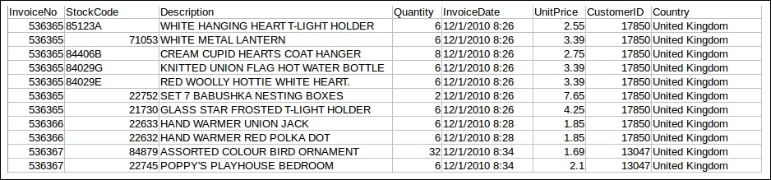
Datasets Overview
A dataset named Online Retail from The UCI Machine Learning Repository
This Online Retail dataset contains the actual transactions between December 1, 2010 and December 9, 2011.
There are 532610 records in this dataset.
Attributes of the dataset

Slide 6

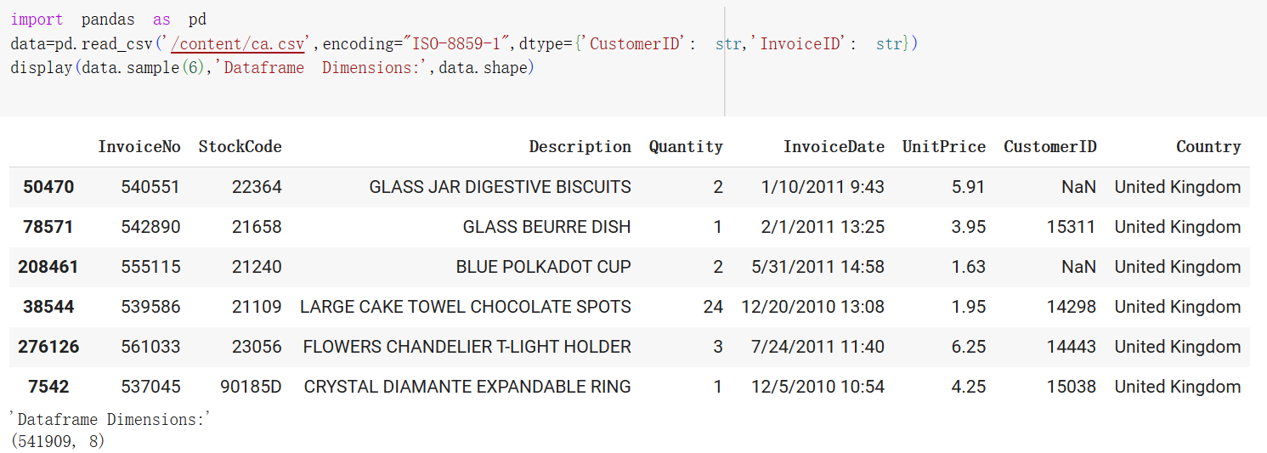
Loading the Dataset
After loading the dataset, we find that the dimensions of the dataset are (541909, 8).

Slide 7


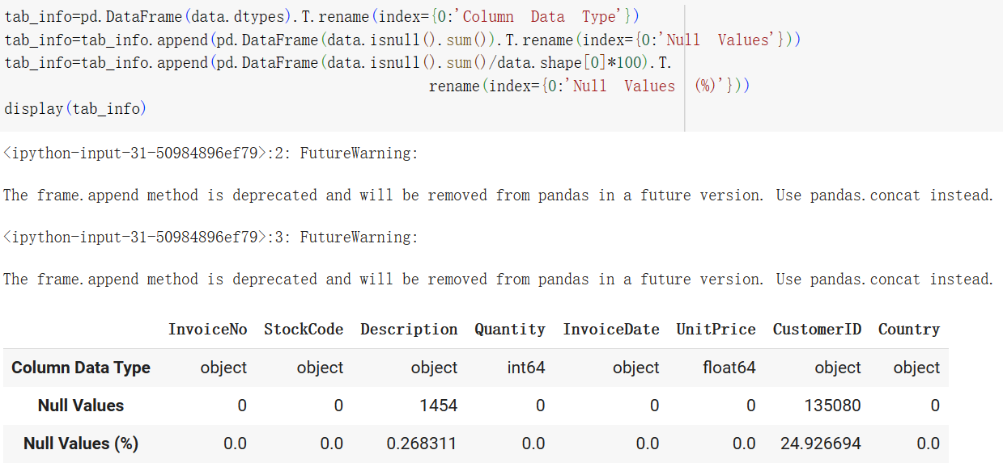
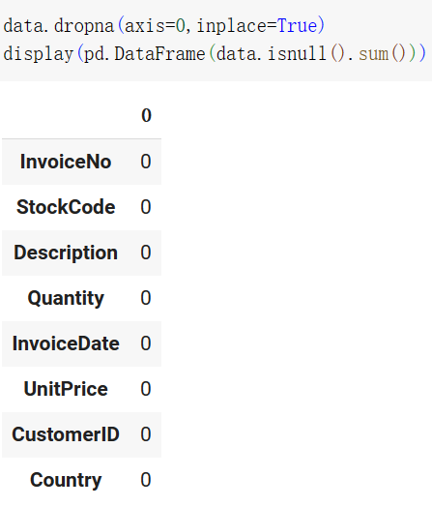

Removing Null Entries
We can observe that for the CustomerID column，there are ~25% data entries that are null.
Deleting the null data entries
The number of null values in each column is 0.

Slide 8
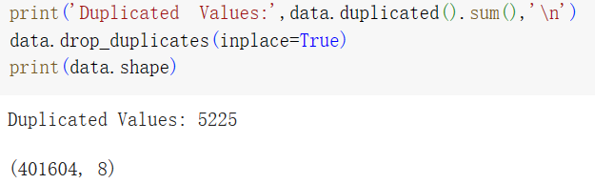
Removing Duplicate Entries
We found 5,225 duplicate data entries. After removing both null data entries and duplicate data entries, the dimensions of the dataset are (401604, 8)

Slide 9

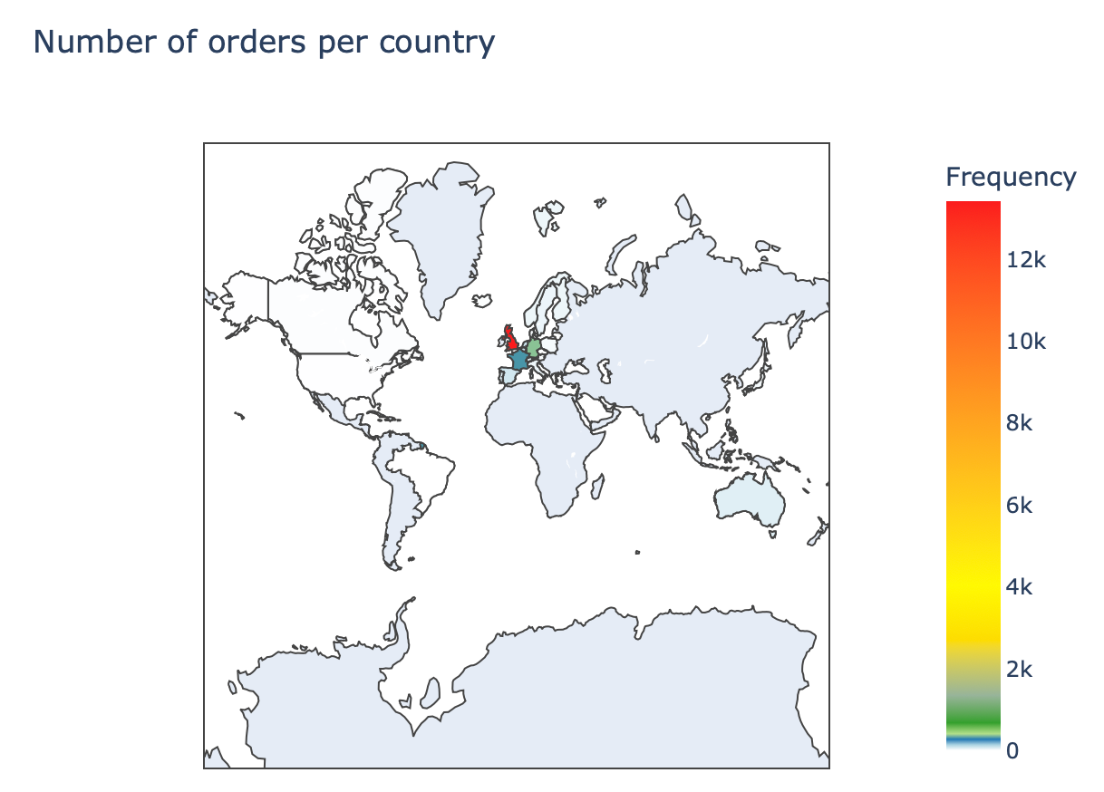
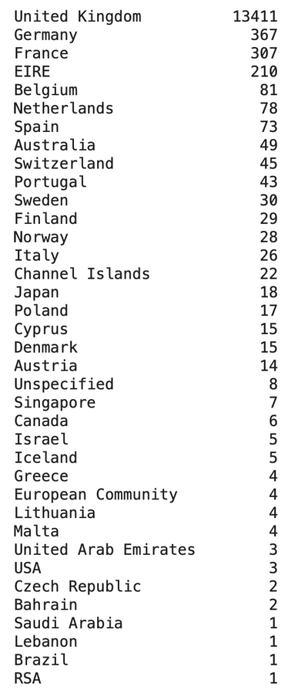
Number of Orders per Country
We extracted the countries the countries from which orders were made and show the result on a choropleth map.
The dataset is largely dominated by orders made from the UK, followed by orders made from Germany, France and Eire.

Slide 10

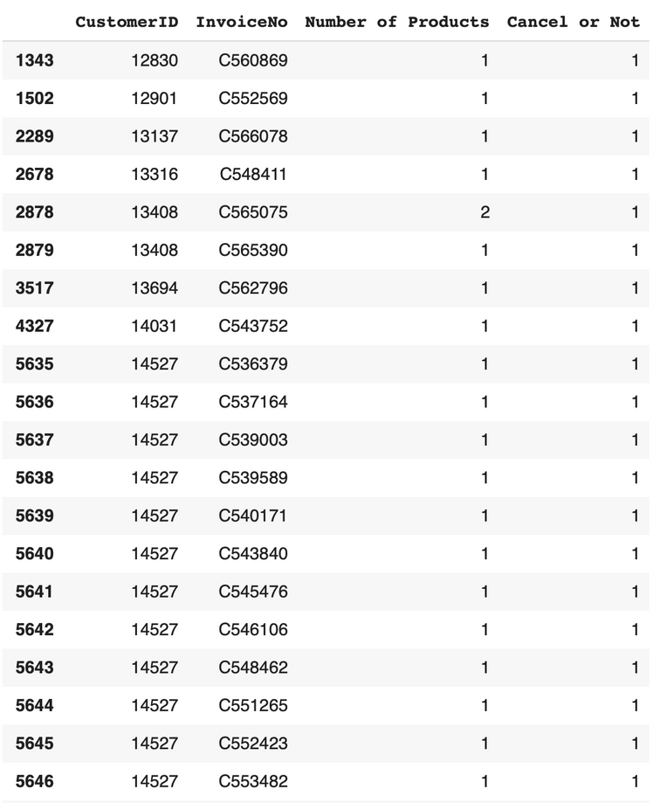
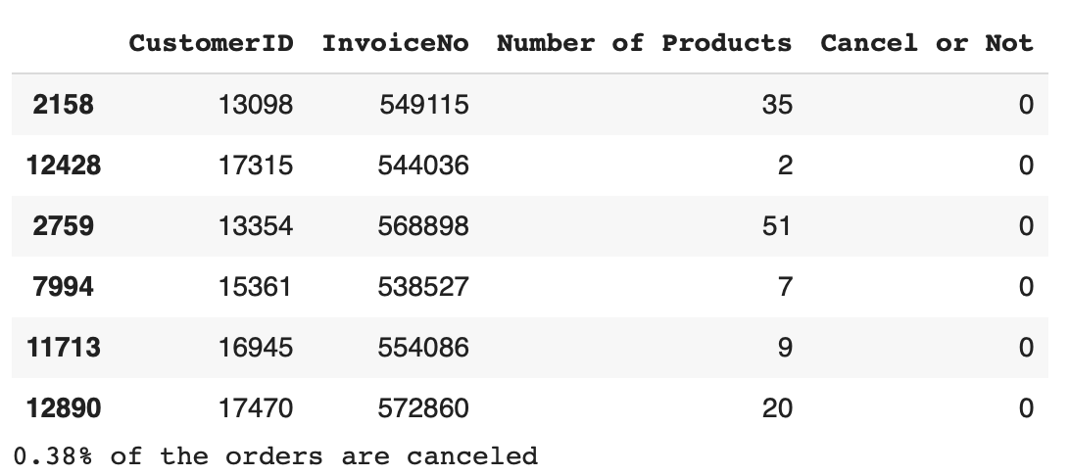
Number of Orders Cancelled
We counted the number of transactions corresponding to canceled orders and removed those orders.

Slide 11

02
——PRODUCT CATEGORIES——

Slide 12



——METHODOLOGY——
Analyzing the product description
DBSCAN (TF-IDF)
Product
Categories
Clustering
K-Means (GloVe)

Slide 13
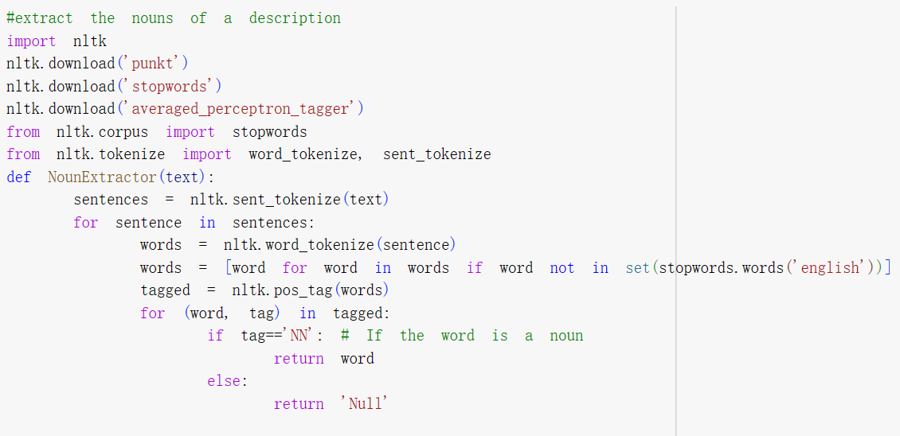
Analyzing the Product Description
Extract the nouns of a description
Define a function called NounExtractor
It tokenizes the text into sentences, removes stopwords (common words like "a," "an," "the," "is," etc.)
Tags the remaining words with their parts of speech
Then, it iterates through the tagged words and checks if each word is a noun
Return words are only nouns and null values

Slide 14
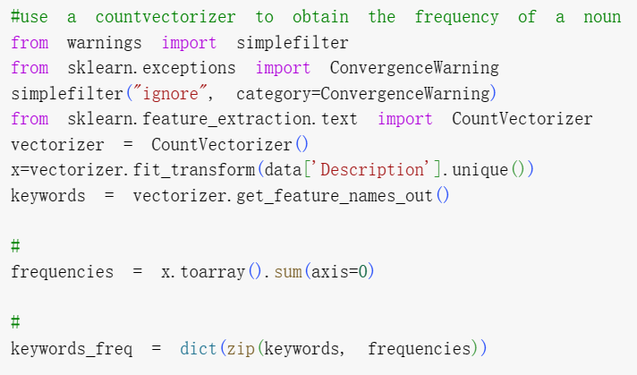
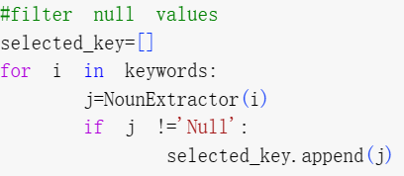
Analyzing the Product Description
Obtain the frequency of a noun
We use scikit-learn's CountVectorizer to obtain the frequency of a noun.
Filter null values
Next, we filter out any null values. This dictionary includes only the keywords that are identified as nouns by the NounExtractor function.

Slide 15
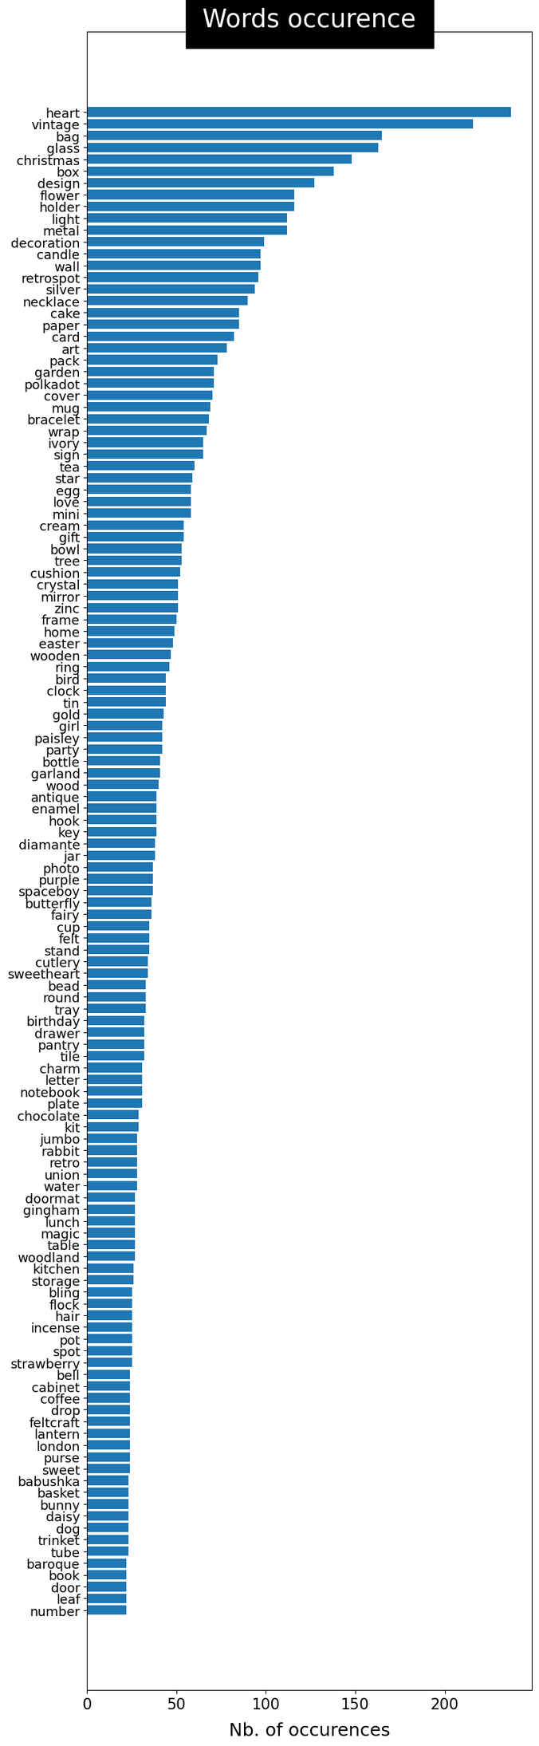
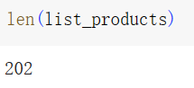

Analyzing the Product Description-Words Occurence
202 description-words in total

Slide 16
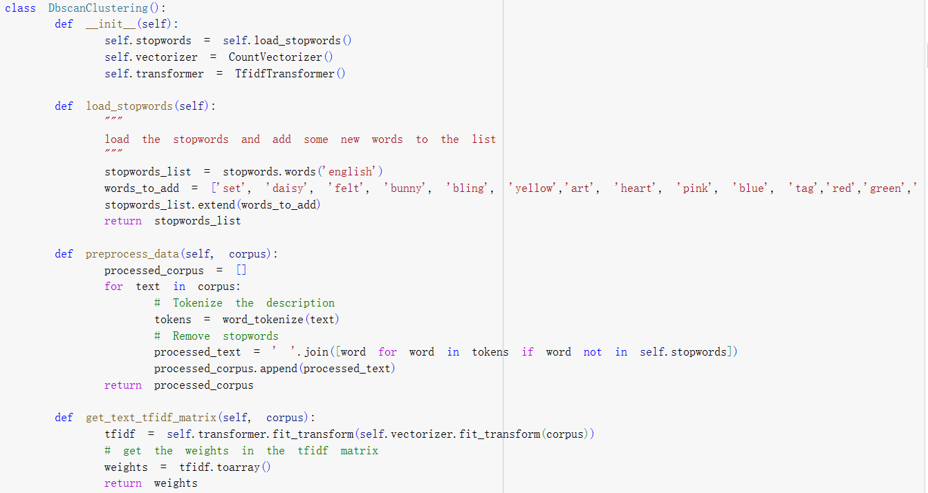
Clustering——DBSCAN(TF-IDF)
Tokenize the descriptions and remove the words that appear in the stopwords list
Use the TFIDF transformer to obtain a TF-IDF value of each word in each description

Slide 17
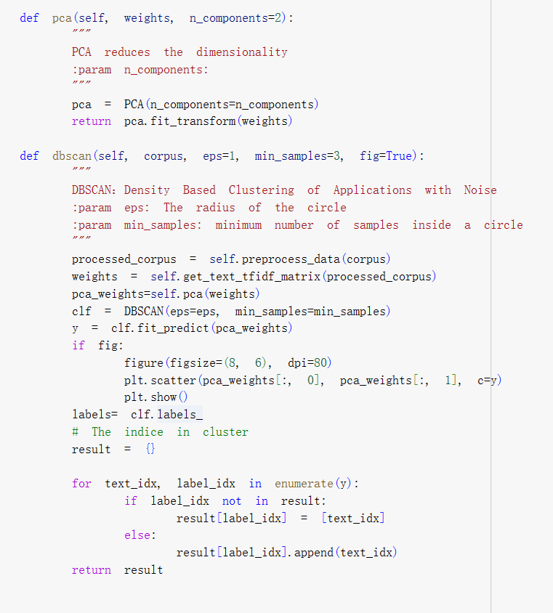
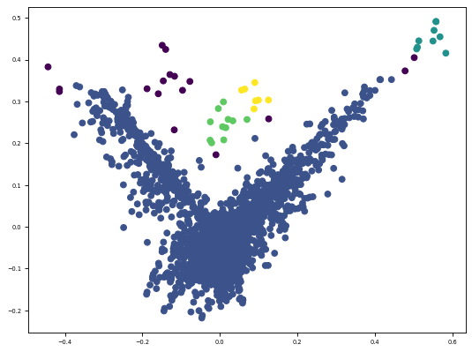

Clustering——DBSCAN(TF-IDF)
Use PCA(Principal Component Analysis) to reduce the dimensionality (to 2)
Plot the clustering results to see if the points are too concentrated or there are too many noise points
Too much variation in the density

Slide 18
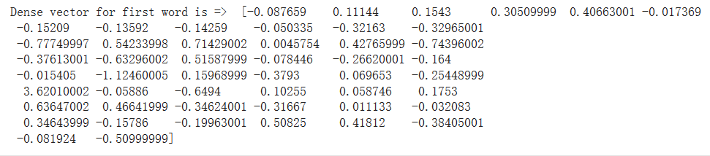
Clustering——K-Means
Build the embedding matrix using GloVe (Global Vectors for Word Representation) word embedding model
the corresponding word: WHITE
Convert a list of text documents into sequences of integer indexes of the words
Calculate the sum of embedding values to create a feature matrix
Reduce the feature matrix to 2 dimensions (PCA)
Create a K-means clustering for each cluster number

Slide 19
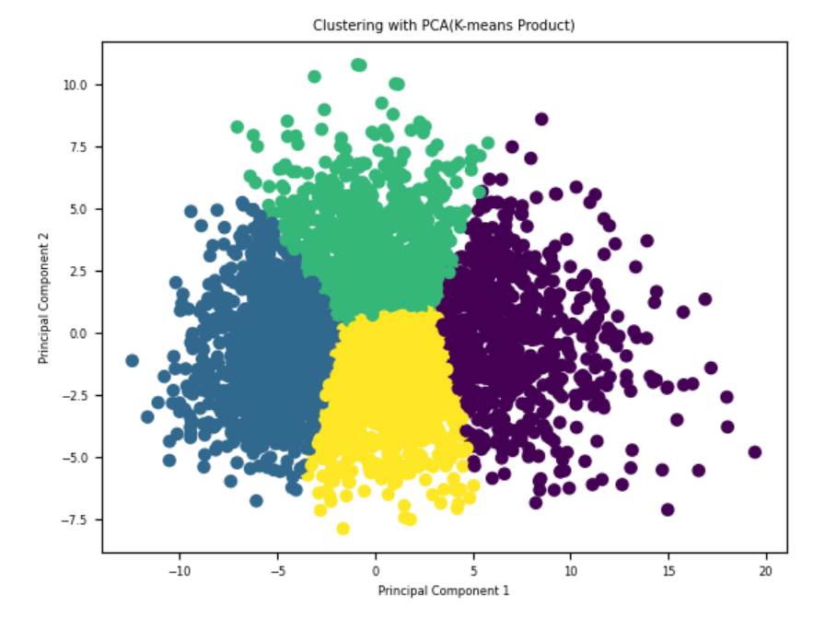

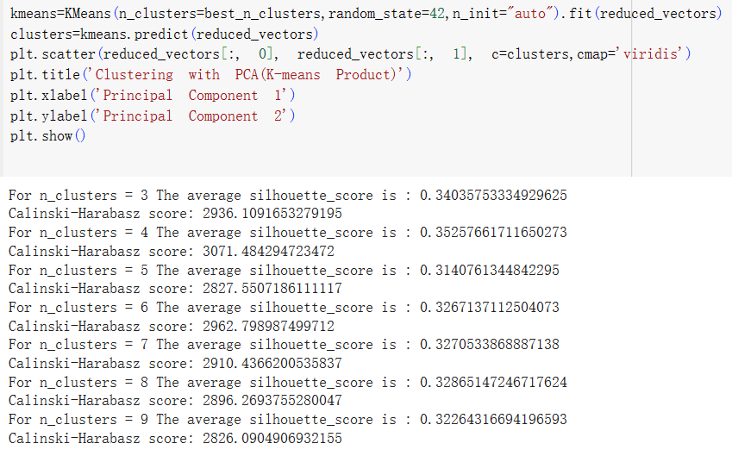
Clustering——K-Means
Choose the best cluster number by comparing the silhouette scores and Calinski-Harabasz scores
Perform the final clustering and visualize the result

Slide 20
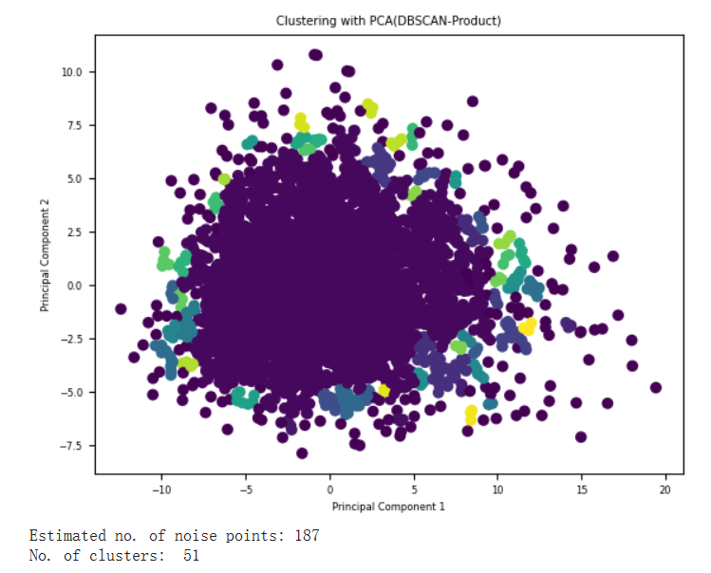


Clustering of Products (Feature Matrix)
Too concentrated points
Too many clusters
Too many noise points

Slide 21

03
——CUSTOMER SEGMENTATION——

Slide 22

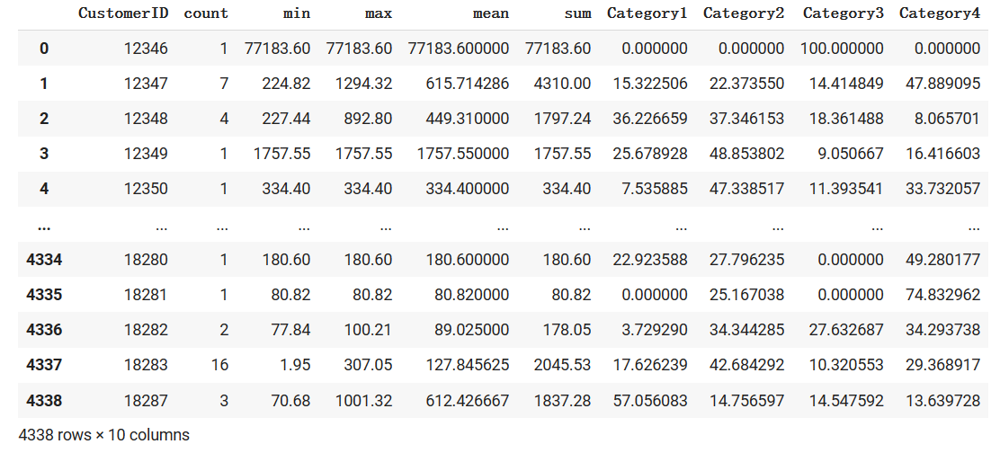
Data Preparation
Label each entry with how much percentage the customer spends on each category

Slide 23

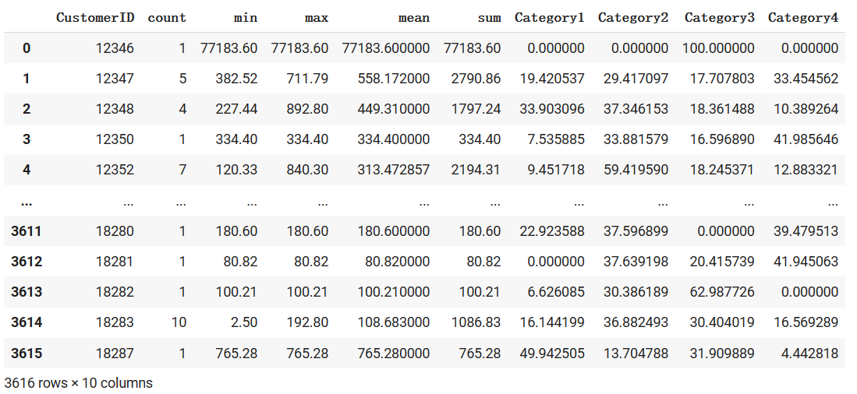

Split the Train and Test Pair
Extract the data before 1 October 2011 to train the models
The data after that date will be used for prediction to test the models
3616 of 4338 entries for training

Slide 24
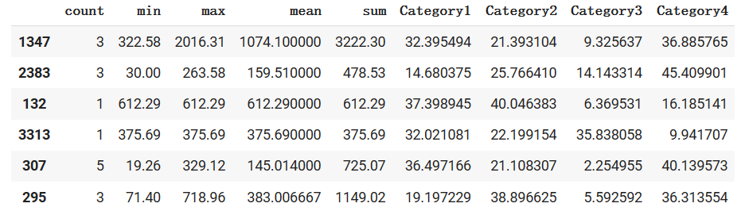

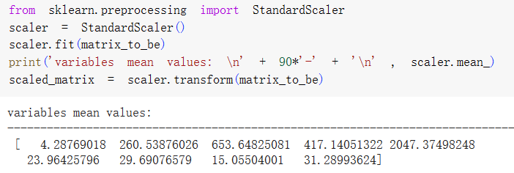
Data standardization
The variance of the data in each column is too large.
Standardize the data to decrease the difference in variations
After standardization, each column now has a variation of 1.

Slide 25
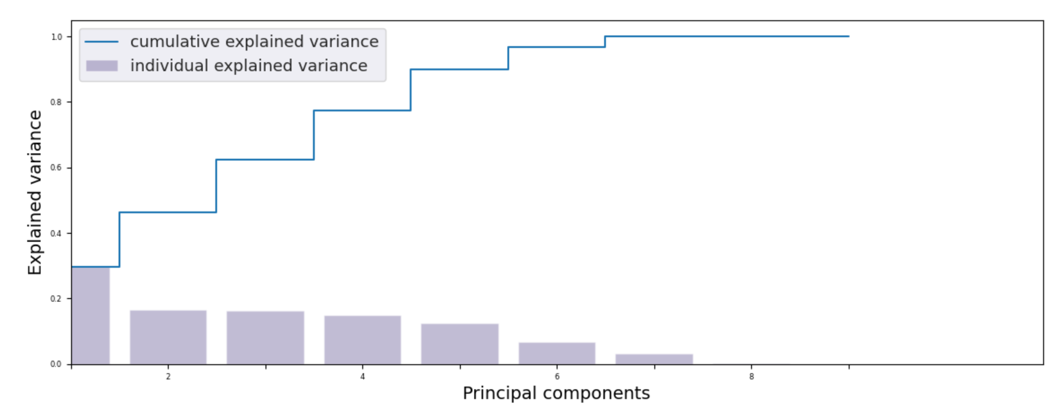
Variance Explained by PCs
7 Principal Components
PC1 Contributes around 30% of the variance

Slide 26
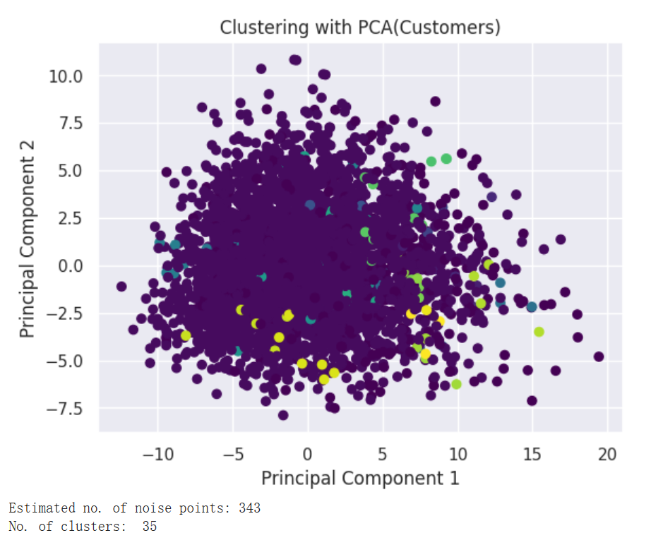
Issues of DBSCAN
Overlapping Clusters
Strict Requirement for Parameter Settings (Misclassified Points)

Slide 27
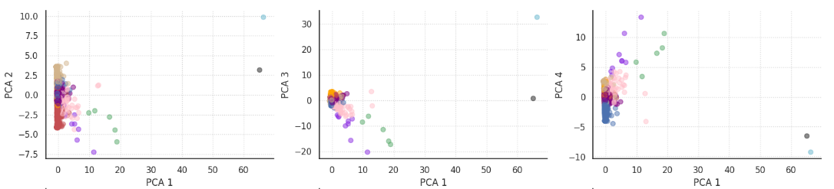
Observations from PCA Plots
No Significant Relationship Between PCs

Slide 28
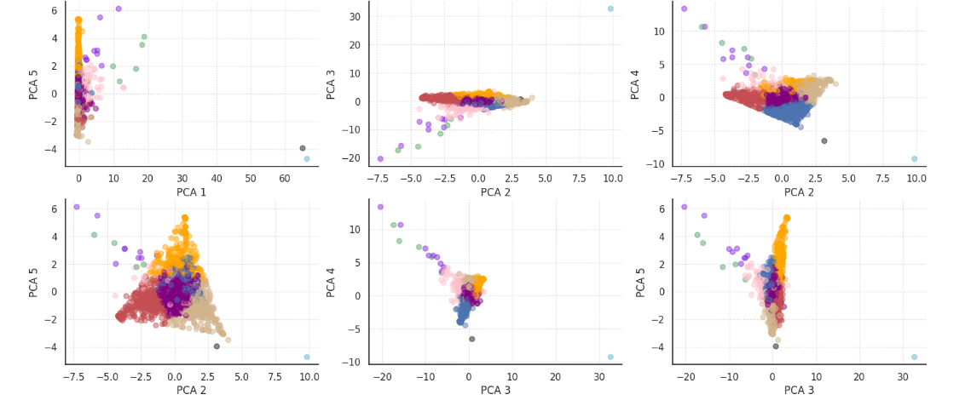
Observations from PCA Plots
Distinct and well-separated clusters
Cohesive points inside a cluster
Balanced Cluster Size

Slide 29
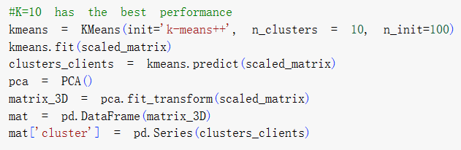
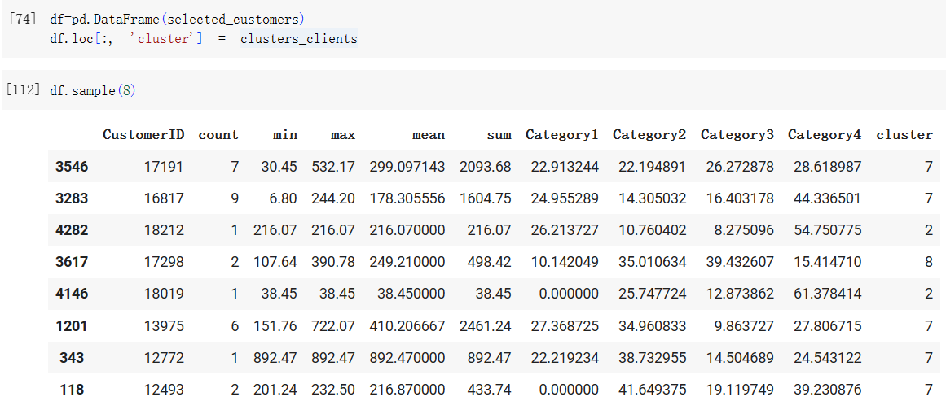
Customer Segmentation
Label each customer with its cluster

Slide 30

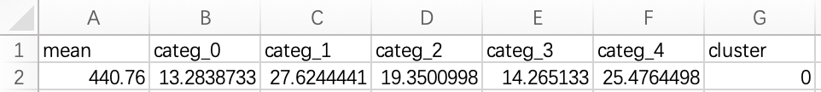

training data.CSV
04
——RECOMMENDER SYSTEM——

Slide 31




RECOMMENDER SYSTEM
MODEL
VOTE
^_^
Improving the accuracy of recommender systems
Overcoming the limitations of individual models
Combine different filters and decide the final prediction through voting
^_^
^_^

Slide 32


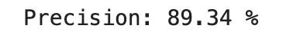


CHOOSING THE MODEL
Support Vector Classifier (SVC)
Random Forest
Logistic Regression (LR)
Gradient Boosting
MLPClassifier
k-Nearest Neighbors (KNN)
Naive Bayes
DecisionTree Classifier
XGBoost

Slide 33
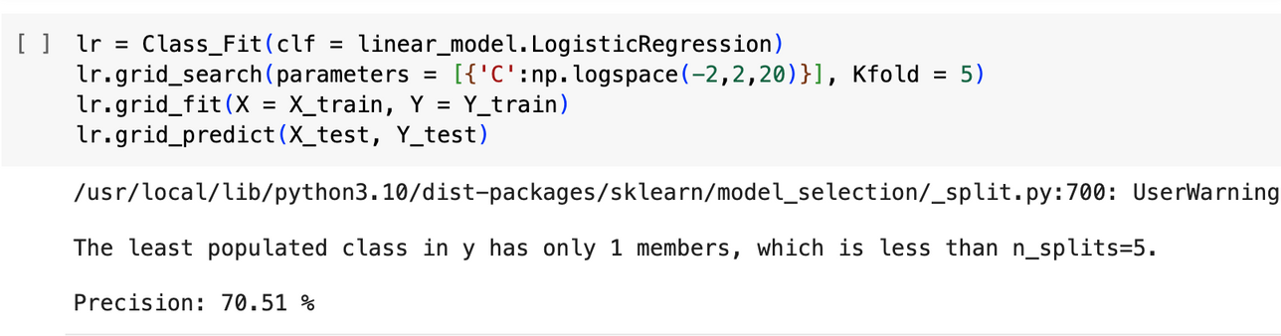
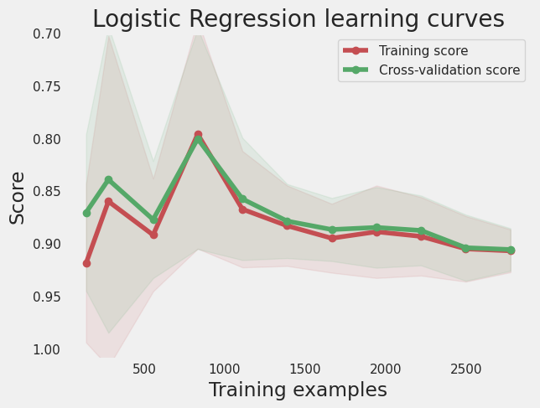
MODEL: Logistic Regression
The output of a logistic regression model can be expressed as a probability estimate representing the observed probability of an event occurring.
If the probability is greater than a certain threshold (usually 0.5), the sample is predicted as a positive class; otherwise, it is predicted as a negative class.
Gap between the two sets decreases as the number of samples increases
The overall trend is relatively stable.
In the yellow segments, the scores basically overlap and are within expectation

Slide 34
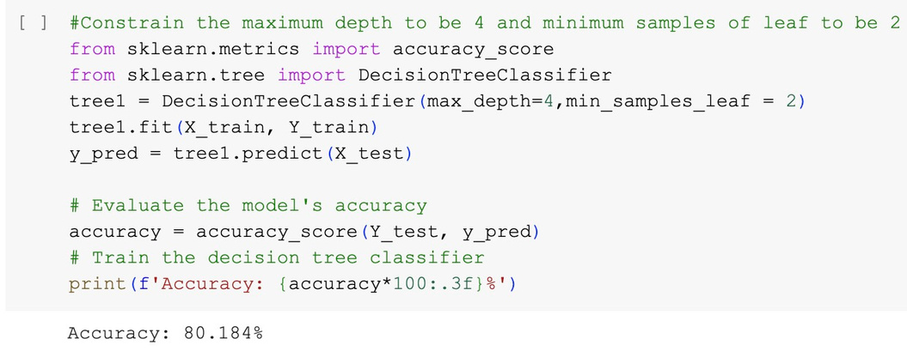
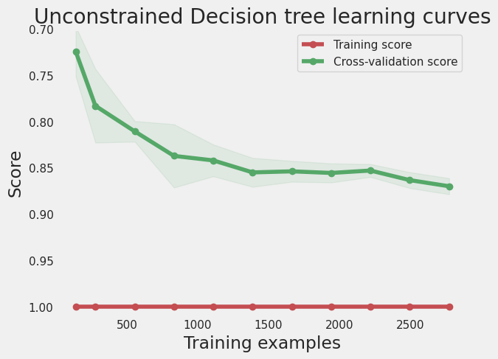
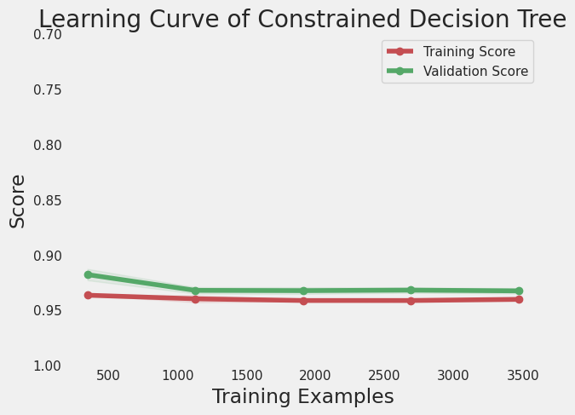
MODEL: DecisionTreeClassifier
A decision tree is a tree structure. At each internal node, selects a feature to segment the data. The selected features are determined based on a certain standard, and the goal is to divide samples of the same category into the same sub-node as much as possible. After selecting the features, the decision tree divides the data set into multiple subsets and repeats the above process for each subset. The best features are selected for segmentation until some stopping condition is met.
The difference between the two sets decreases as the number of samples increases.
The whole trend is very stable.
But there is almost no overlap in scores
overfitting

Slide 35
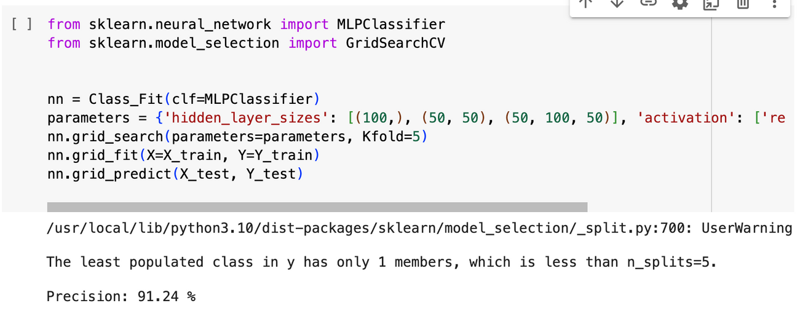
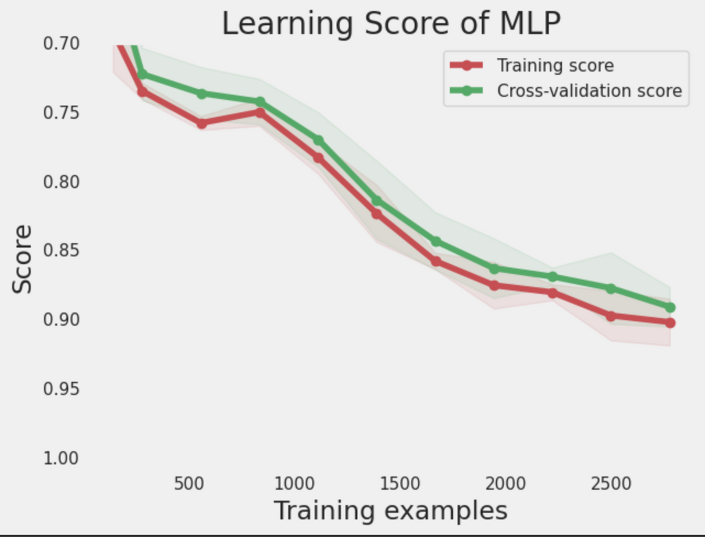
MODEL: MLPClassifier
Model may have good generalization ability and accuracy
No obvious overfitting problem with the model.

Slide 36
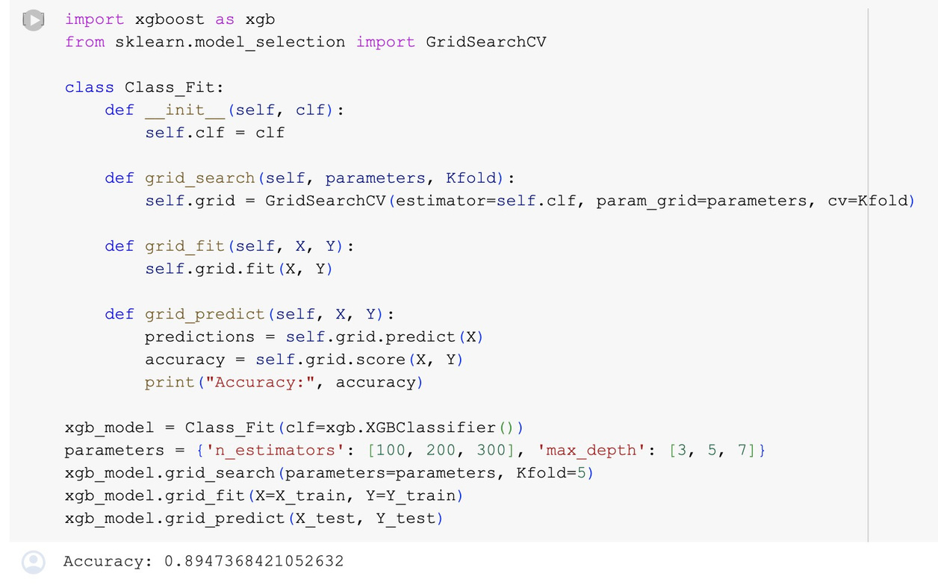
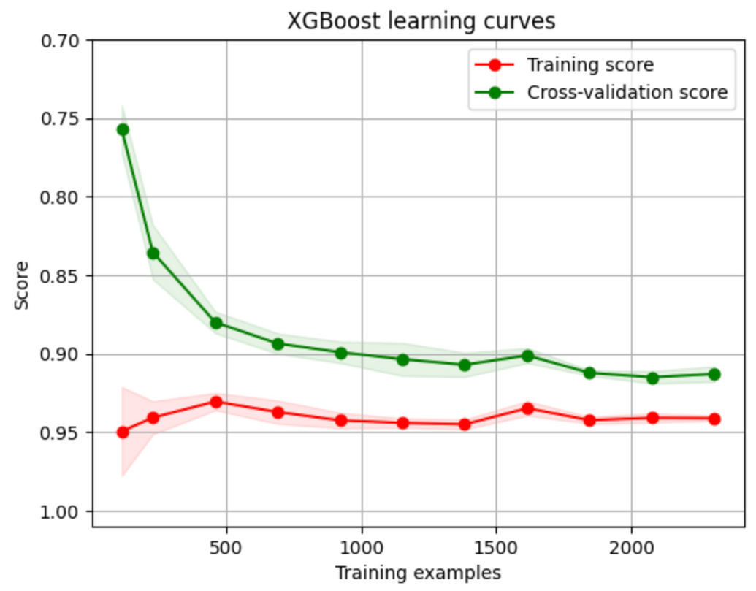
MODEL: XGBoost

Slide 37
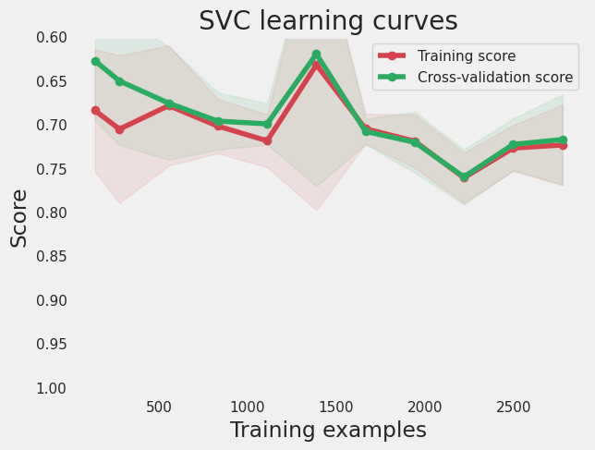
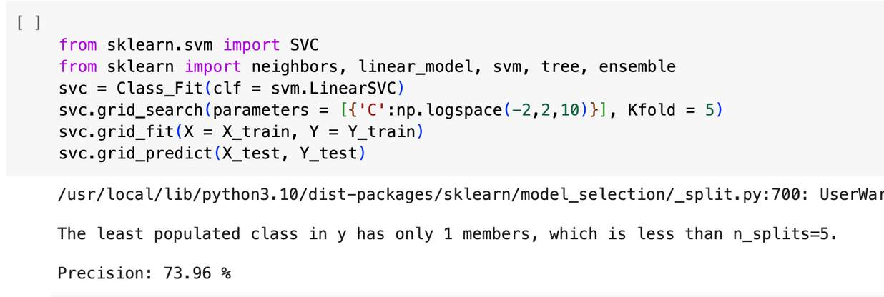
MODEL: Support Vector Classifier (SVC)

Slide 38
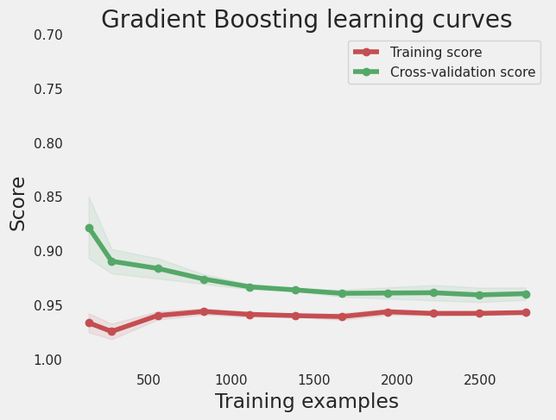
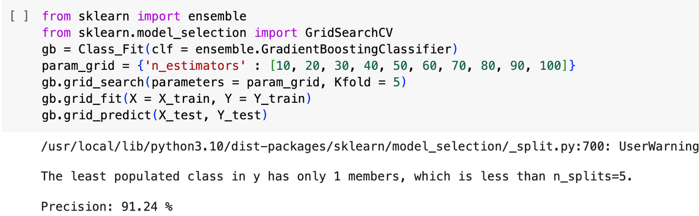
MODEL: Gradient Boosting

Slide 39
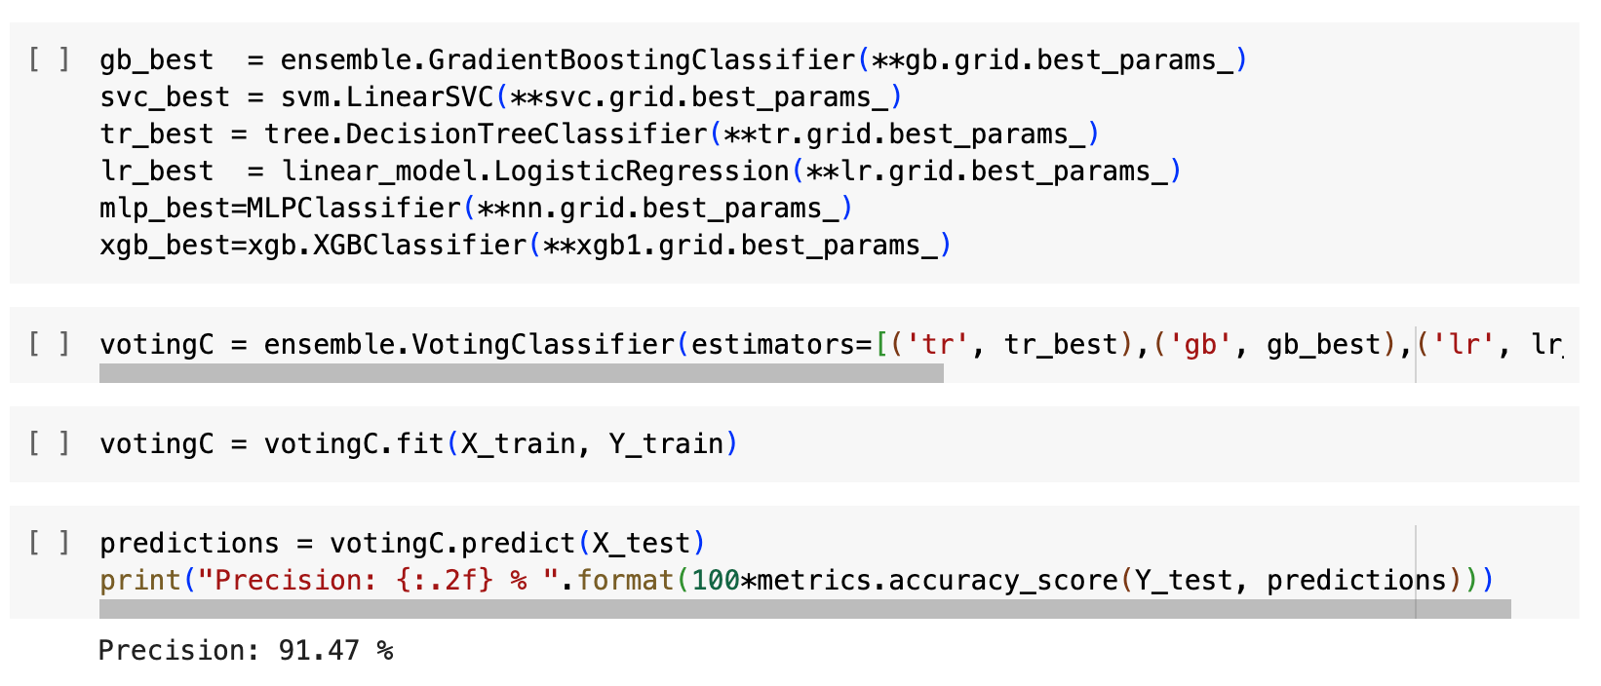
VOTE
create a voting classifier
votingC = ensemble.VotingClassifier(estimators=[('tr', tr_best),('gb', gb_best),('lr', lr_best),('mlp',mlp_best),('xgb',xgb_best)], voting='soft')

Slide 40

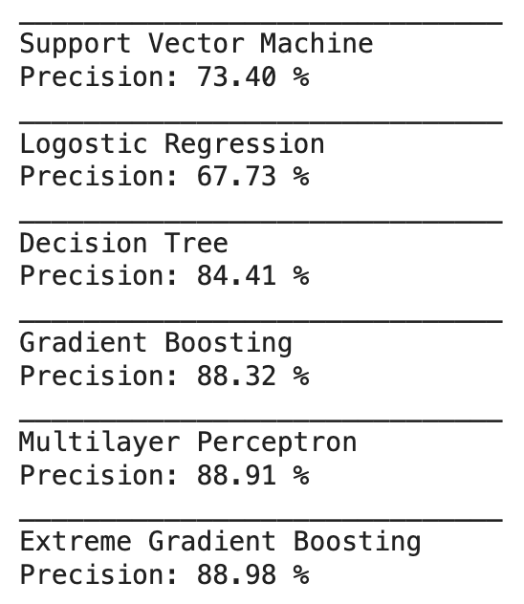
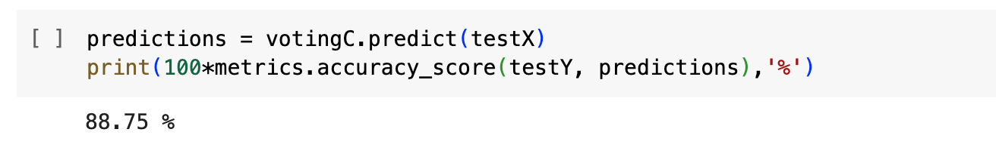

VOTE
We combine all models’ prediction results
Enhance the quality of the voting classifier.
votingC = ensemble.VotingClassifier(estimators=[('tr', tr_best),('gb', gb_best),('lr', lr_best),('mlp',mlp_best),('xgb',xgb_best)], voting='soft')

Slide 41



—— Conclusion ——
Max and Mean: The two most significant factors
Why?
Not sufficient entries of unique product descriptions
Little correlation between the products in the same cluster
Lack of customers’ personal information

Slide 42

THANK'S FOR LISTENING

